Slide 1
Seminar: Environmental Economics
Carbon Taxation and Inequality
Rasmus Lindø Kaslund
Julie Deding Nielsen

Slide 2

Motivation
The Danish Climate Act of 2019: Reducing emissions by 70 pct.
Notes:
Anton

Slide 3
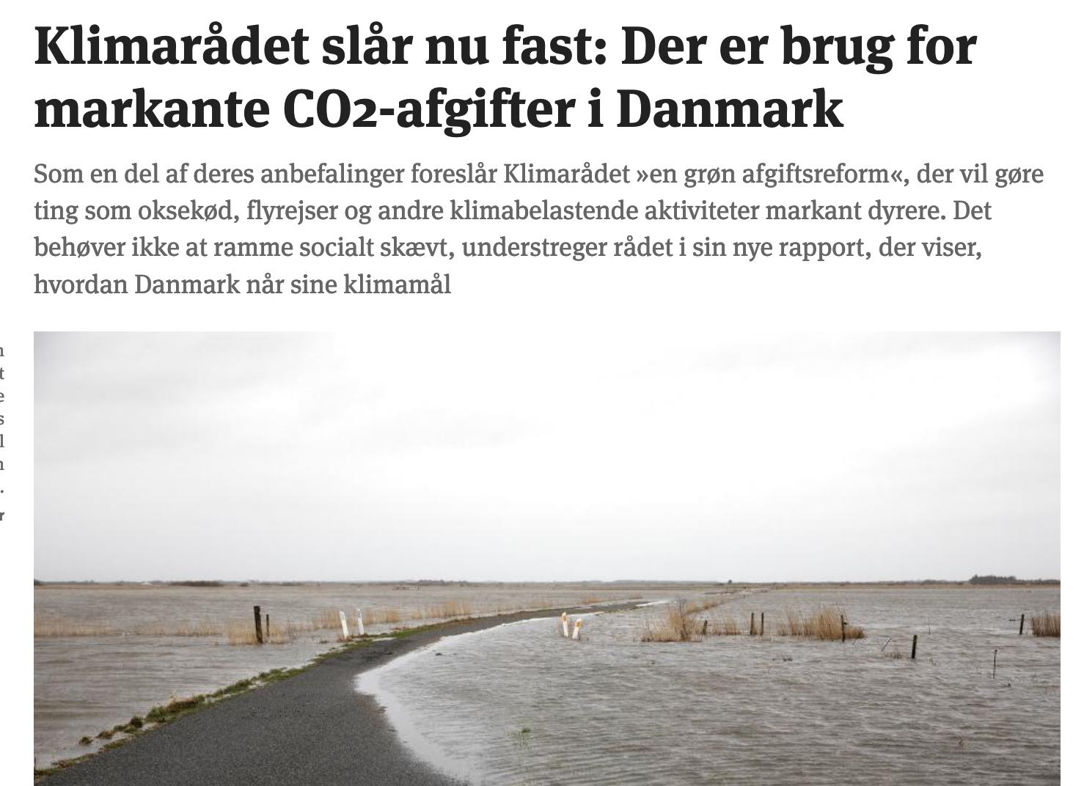
Motivation
Carbon taxation might be an important tool
Notes:
Anton

Slide 4
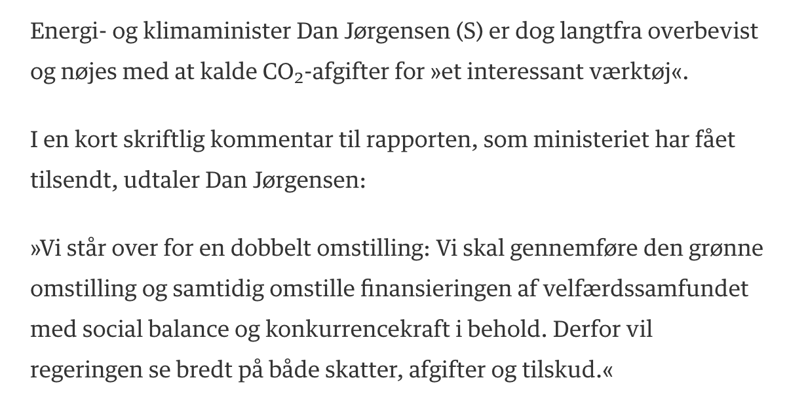
Motivation
A carbon tax meets opposition from the highest level
From Berlingske Tidende: “Mangedobling af klimaafgift møder modstand”
Notes:
Anton

Slide 5

Motivation
But will a carbon tax actually increase inequality?
Notes:
Anton

Slide 6
Research question
Will a tax on carbon emissions lead to higher inequality in Denmark?

Slide 7
Key issues and methods
We evaluate the (direct) regressivity of a carbon tax
Following Wier et al. (2005) we assess the regressivity of the current Danish Carbon tax
Using the method of Wier et al. (2005), we evaluate the (short run) impact of a 1000 DKK/ton carbon tax, as proposed by Kraka (2020) and Danish Climate Council (2020)
Combining the method Wier et al. (2005) and Klenert et al. (2018) we evaluate the regressivity of a 1000 DKK/ton carbon tax in the long run.
Evaluating the impact on inequality after redistribution
We set up a model inspired by Klenert et al (2018) and calibrate it to a Danish setting
Then we evaluate different redistribution schemes

Slide 8
Input-output model
We use an input-output model to analyze short-run the impact of carbon taxation
An important assumption of our input-output model is that there is no substitution between goods or inputs in production

Slide 9
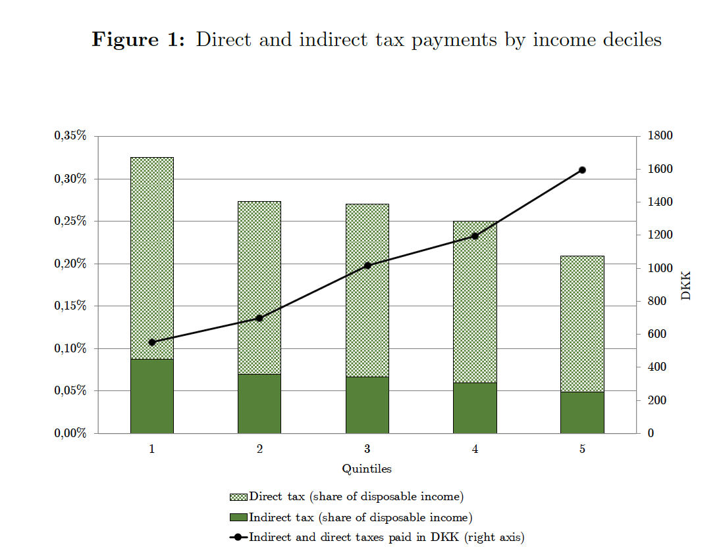
Results: Current Danish carbon tax

Slide 10
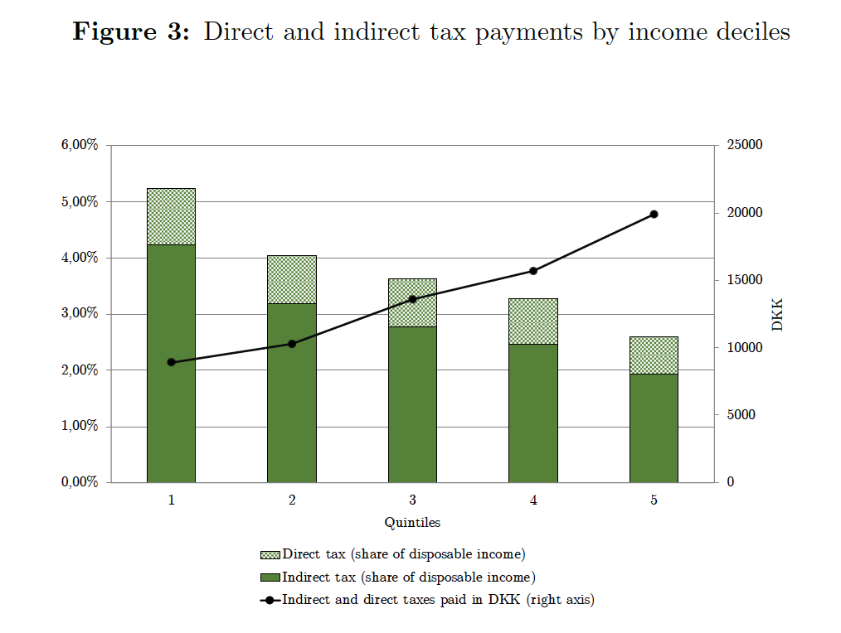
Results: 1000 DKK/ton carbon tax

Slide 11
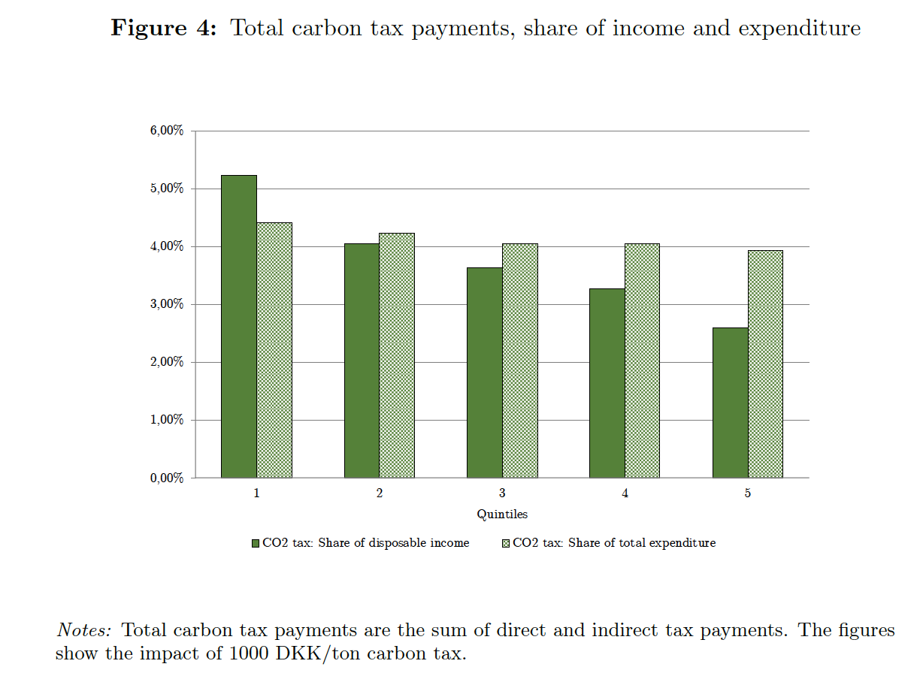
Results: 1000 DKK/ton carbon tax

Slide 12
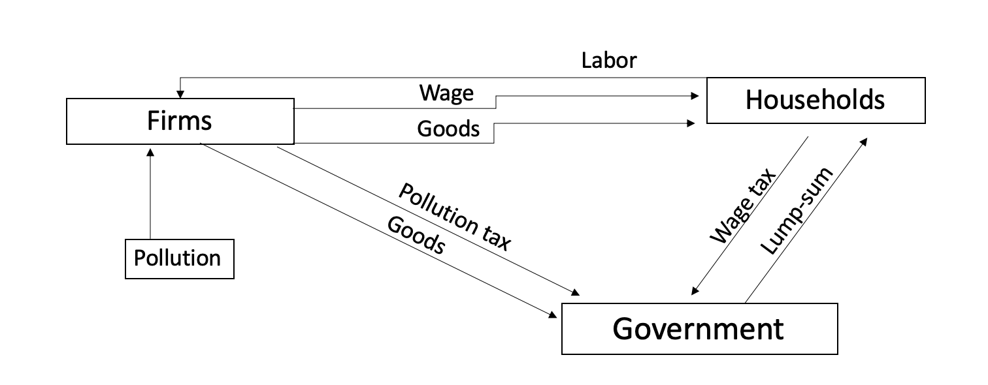
CGE Model
Pollution is modelled as an input to production
Utility of households requires a minimum consumption level for certain good
Households are distinguished by their productivity
The government can foresee all actions and maximize total welfare through taxes and lump sum transfers

Slide 13
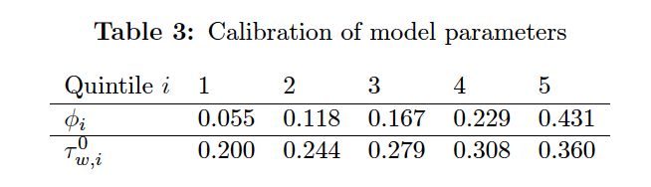
CGE Model
Calibration
We calibrate productivity levels and and income taxes to Danish income data:
We calibrate the carbon emissions share in the production function using Danish data on carbon emissions
We calibrate our carbon tax such that the impact (in percentage of income) corresponds to the impact we found in our input-output analysis for a 1000 DKK/ton tax.

Slide 14
CGE Model
We evaluate four different carbon tax reforms:
Without redistribution (government spends extra revenue)
Redistribution through differentiated income tax cuts
Redistribution through uniform income tax cuts
Redistribution through lump sum transfers

Slide 15
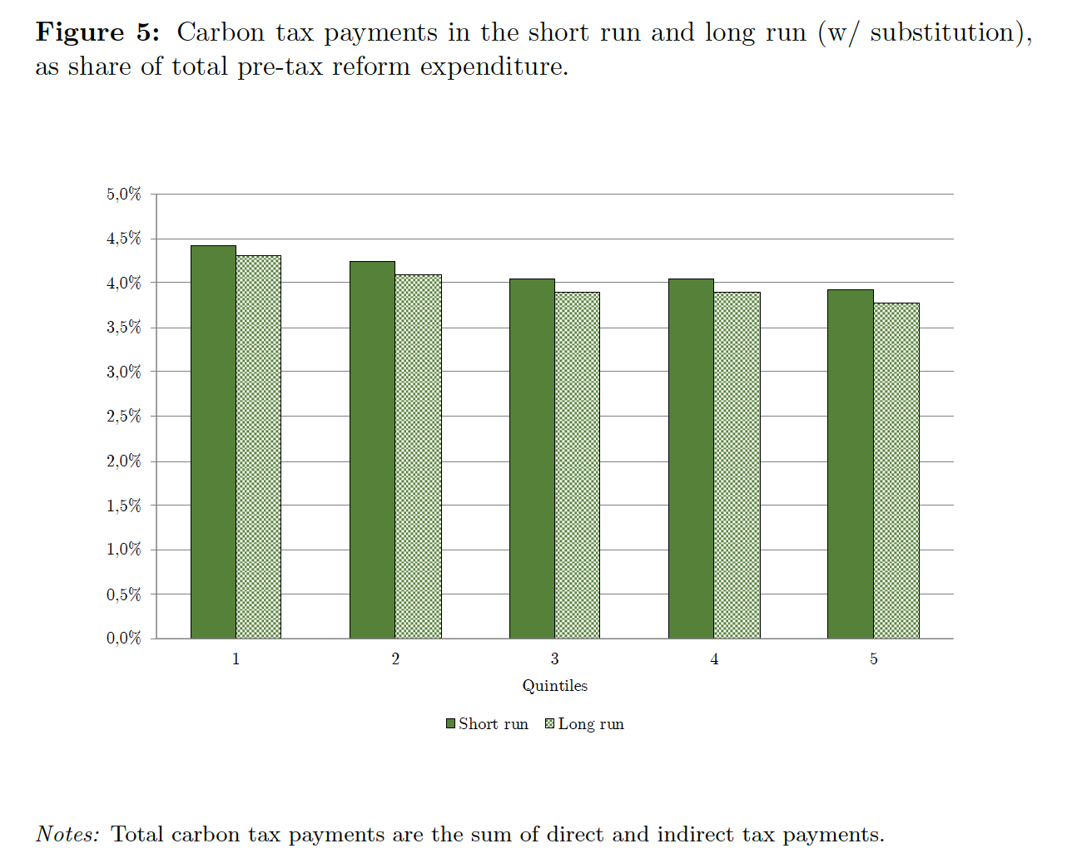
Results: No redistribution
We compare with our I/O-model to obtain estimates of the short and long run impact:

Slide 16
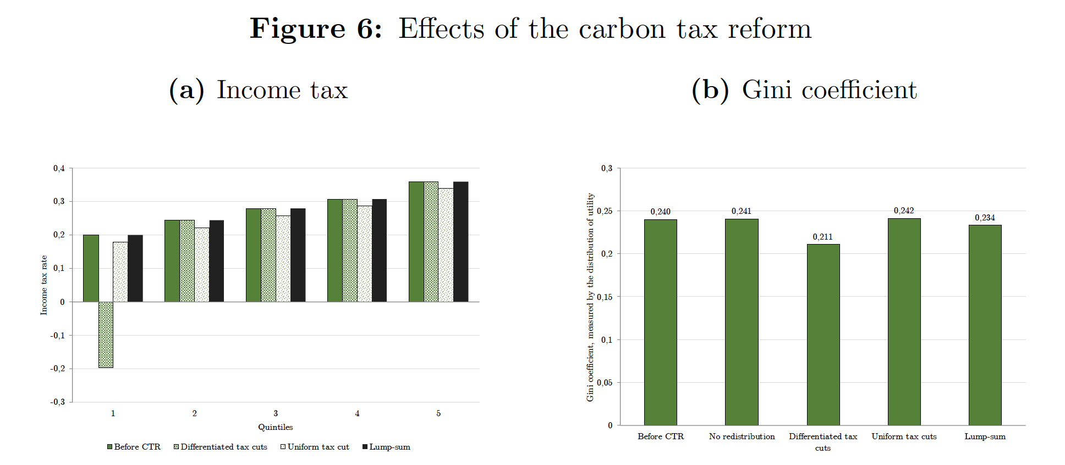
Results: Redistribution
We evaluate the distributional impact comparing the distribution of income tax cuts and utility.

Slide 17
Discussion: Limitations to our model
Closed economy and carbon leakage
Intra-category substitution (beef versus chickpeas, coal vs wind power)
The minimum consumption levels lack empirical basis
Public sector and taxation is heavily simplified
No structural change/static model

Slide 18
Conclusion
A carbon tax is, ceteris paribus, regressive, as low-income households spend a higher share of their income on polluting goods.
However, through redistribution of the revenue, a carbon tax reform can decrease inequality.
Our analysis suggests that if a carbon tax is accompanied by a climate ‘bonus’ or green check, it will not raise inequality.

